Slide 1
Yelp reviews NLP and Classification
Isabelle Tontchev

Slide 2
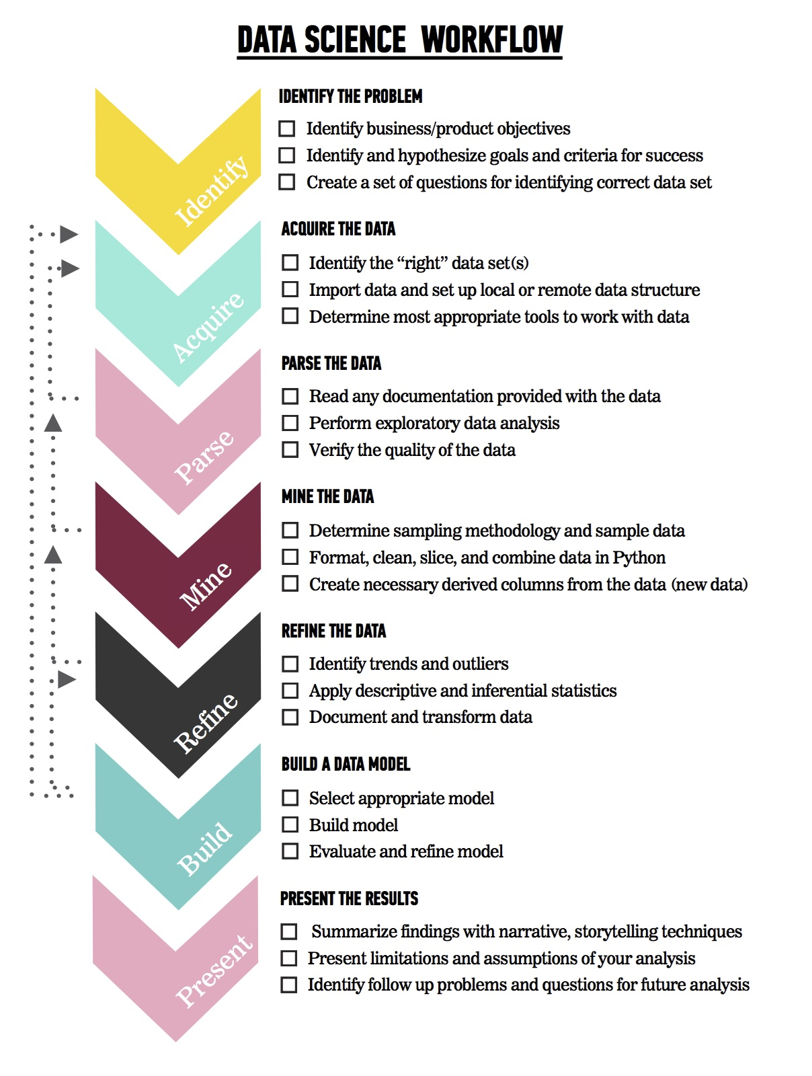
Data Science Workflow
Identify the problem
Acquire the data
Parse the data
Mine the data
Refine the data
Build a model (...break a model then fix it)
Present the results

Slide 3
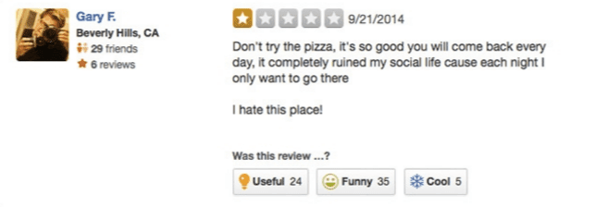
Funny not funny classifier?..
Notes:
Problem: unbalanced dataset. Baseline 80%. Reading around I feel like it would be a very hard problem.
Humour is context related. Seemed like a more complex problem. So I moved to the useful ratings.

Slide 4
Identify the problem
Can I conduct NLP to predict whether a review has been classed as useful?
can I use this insight to recommend to a business on how they can improve their products or services on offer?
Target: A reviews useful rating (0 or 1)
Predictor: Customer review

Slide 5

Acquire the data
8,021,122 unique reviews
209,393 businesses
10 metropolitan areas

Slide 6
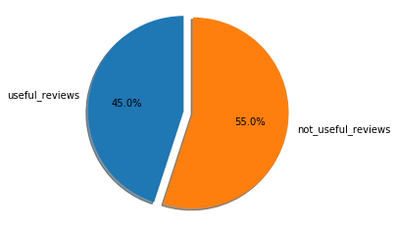
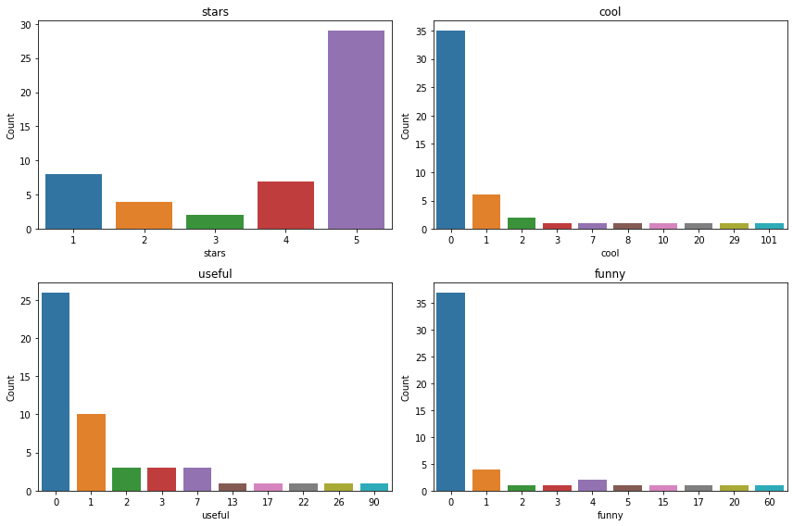
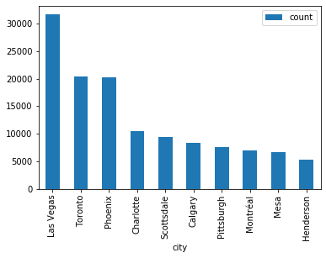
Parse the data
Notes:
Here’s the distribution of star ratings, useful/cool/funny ratings across the reviews.
I’m looking here at the spread of review descriptors as assigned by readers of the reviews.
Binary classifier, 0 is not usefull and anything >0 is useful.
About half the reviews are marked as useful so it’s a balanced dataset, the others are less so.
Looked at spread of reviews by city. It occurred to me that an interesting future analysis might be to focus in on one city or one business.

Slide 7
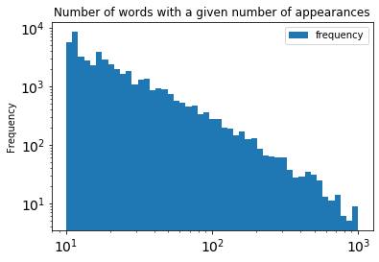

Mine the data
1% reviews in foreign language, ~ 80k reviews.
I used lang detect python package to identify languages and then filter out non- ‘en’ languages.
I used SQL to randomly sample the data and I used 100k observations.
Notes:
Zipf's law states that given a large sample of words, the most frequent word will occur about twice as often as the second most frequent word, three times as often as the third most frequent word, etc. For example, in one sample of words in the English language, the most frequently occurring word, "the", accounts for nearly 7% of all the words (69,971 out of slightly over 1 million). True to Zipf's Law, the second-place word "of" accounts for slightly over 3.5% of words (36,411 occurrences), followed by "and" (28,852). Only about 135 words are needed to account for half the sample of words in a large sample.^{[3]}
I didn’t have a methodology for this and I am not sure how representative this sample is of the whole population. In future I could conduct a hypothesis test to see how much of the sample I would need for a confidence interval of 99%.

Slide 8
Feature extraction & Build a model
Count Vectorizer (ngrams 1,1)
65,796 model features
Train score: 0.807
Test score: 0.601
Train CV: 0.594
Count Vectorizer (ngrams 2,2)
1,922,891 model features
Train score: 0.999
Test score: 0.588
CV score: 0.590
TF-IDF Vectorizer (ngrams 1,1)
65,796 model features
Train score: 0.639
Test score: 0.629
Train CV: 0.626
TF-IDF Vectorizer (ngrams 2,2)
1,922,891 model features
Train score: 0.685
Test score: 0.587
CV score: 0.590

Slide 9
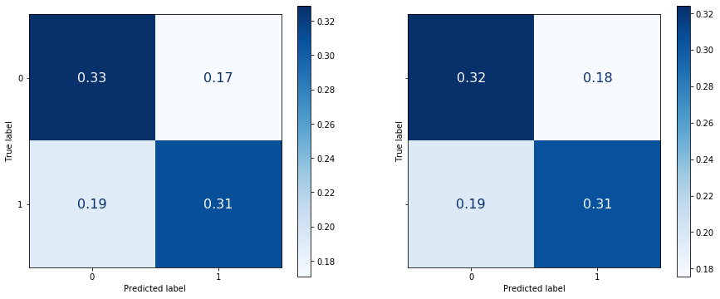
Present the results - Gridsearch TF-IDF
TF-IDF & Logistic Regression (1,1)
1000 max features and min df 20
Train score: 0.626
Test score: 0.640
CV score: 0.629

Slide 10
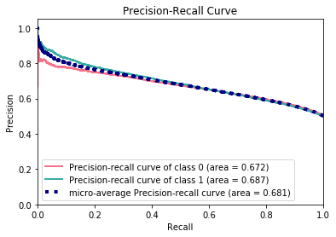
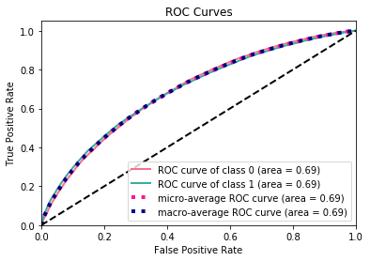
Present the results
TF-IDF & Logistic Regression (1,1) continued

Slide 11
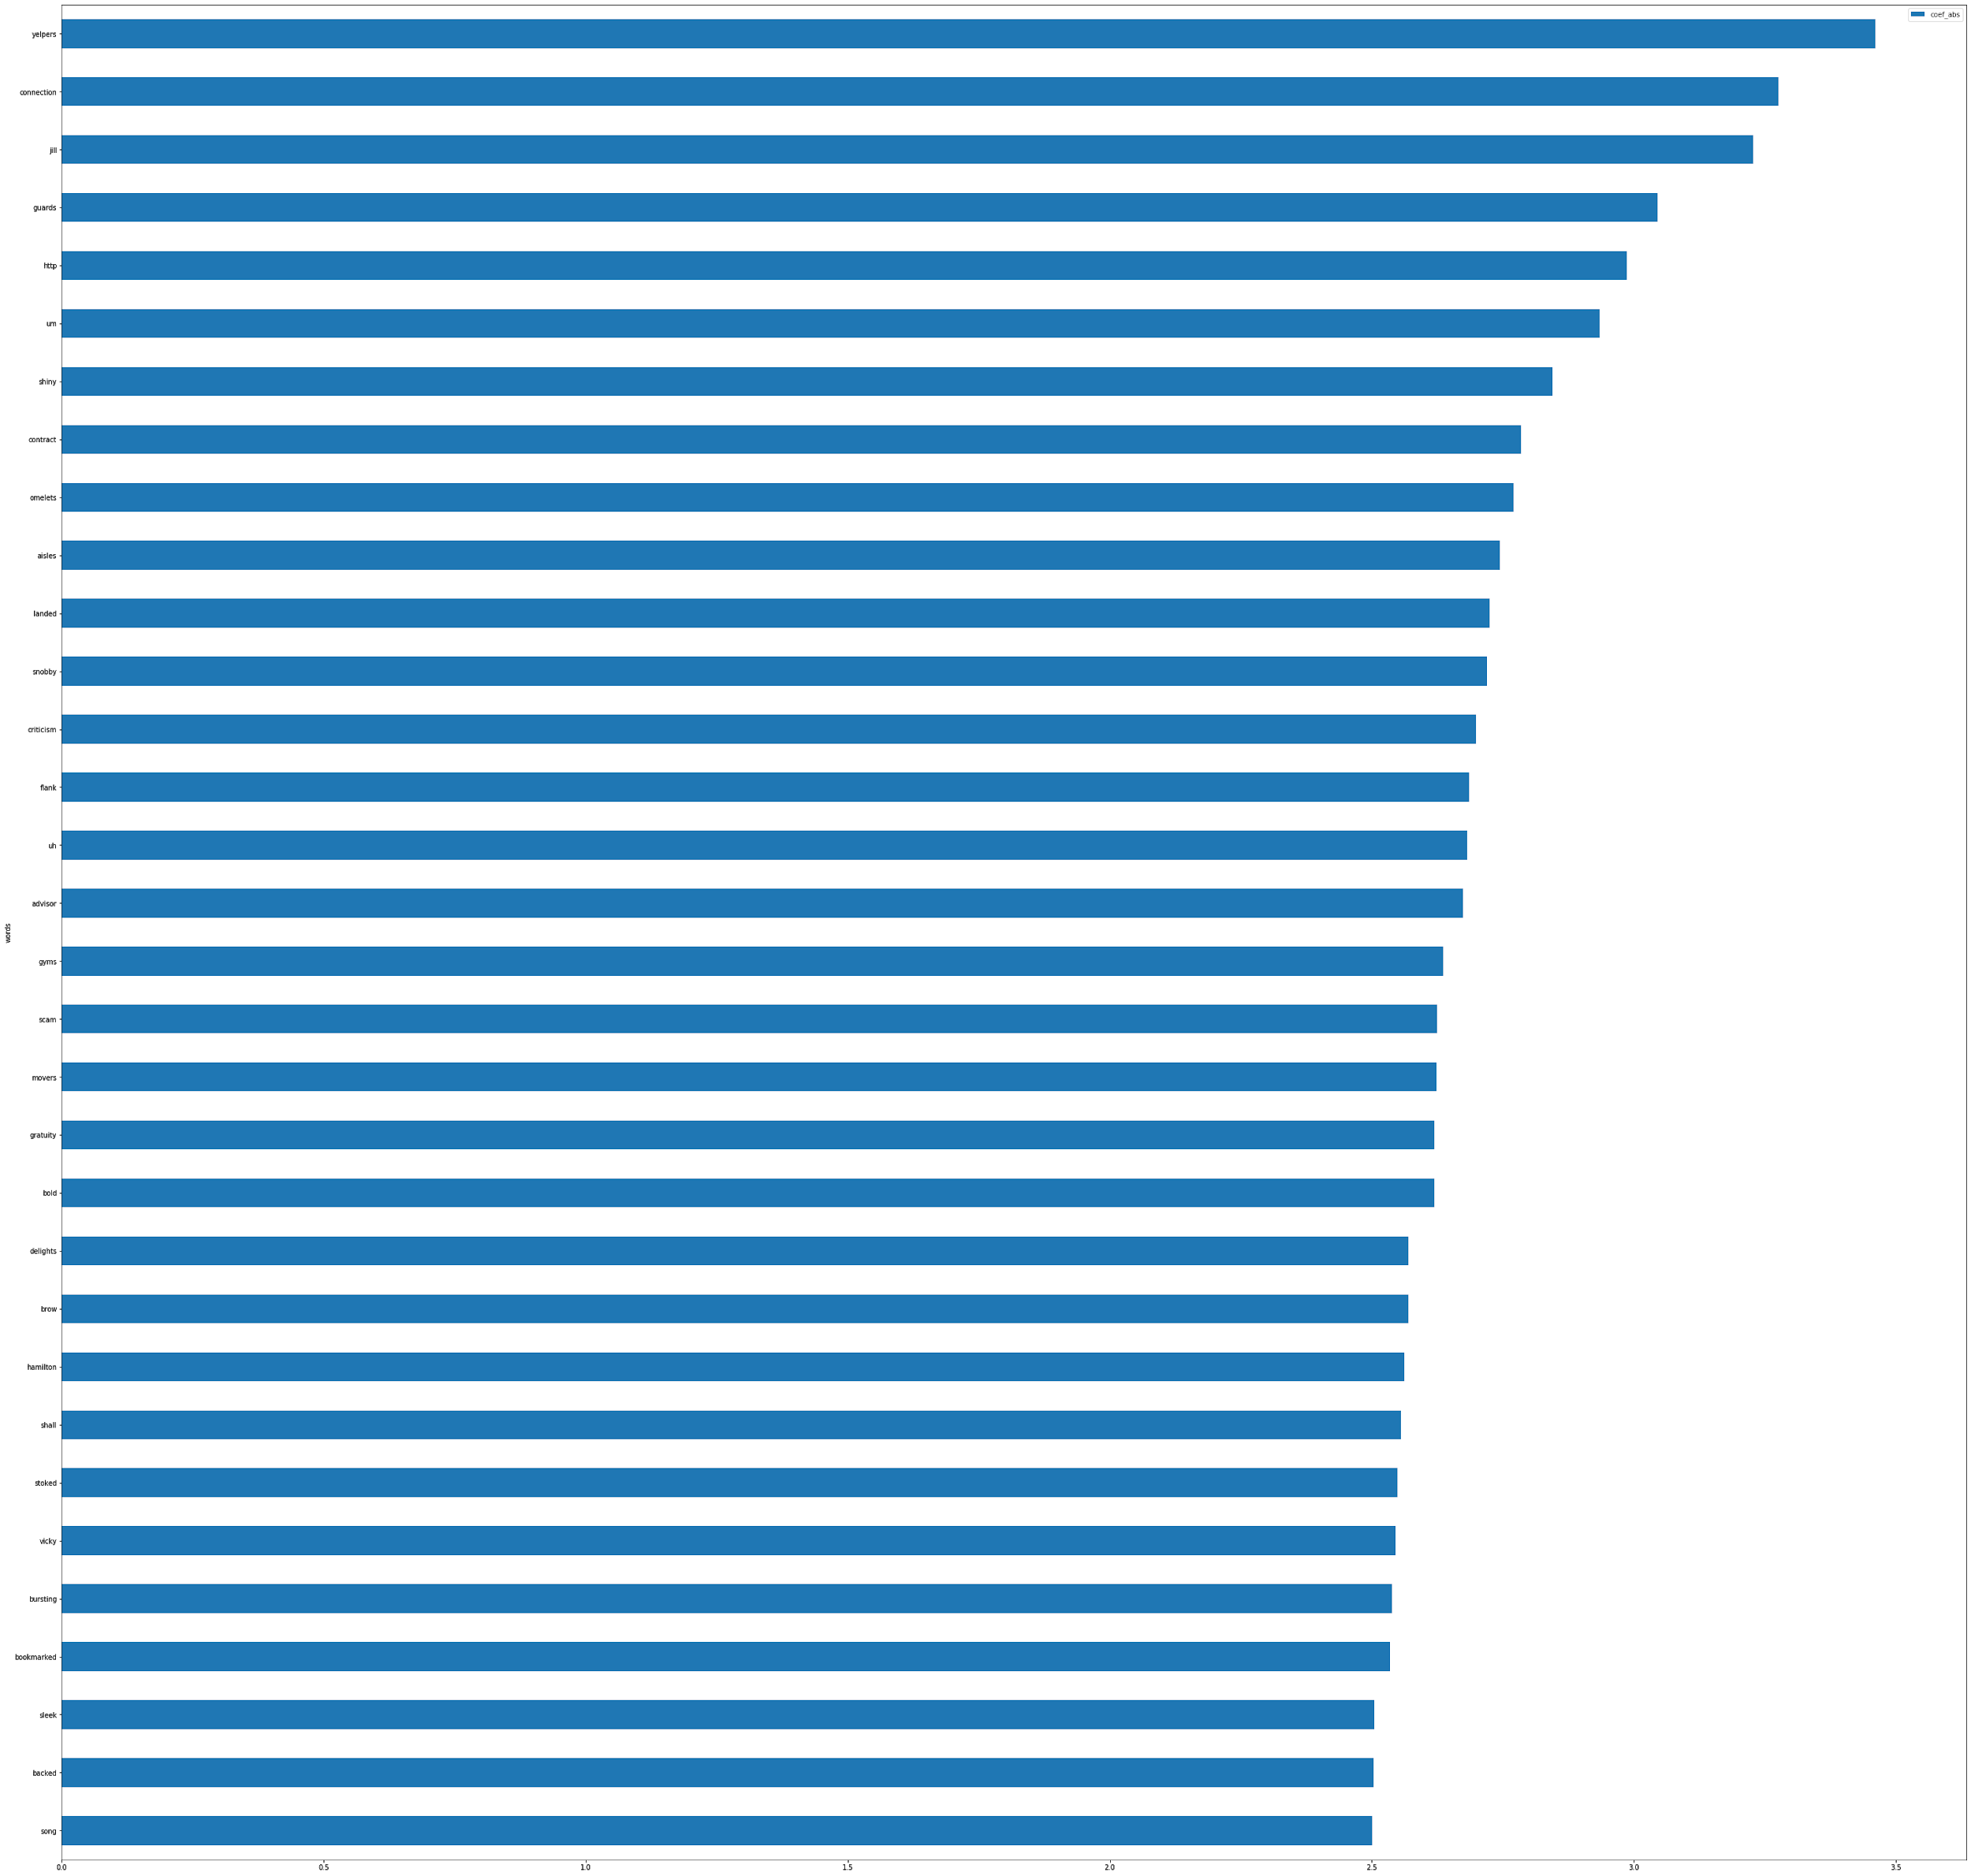
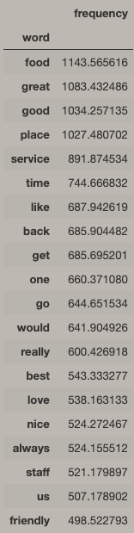
Present the results
Logistic regression coefficients
ngrams(1,1)

Slide 12
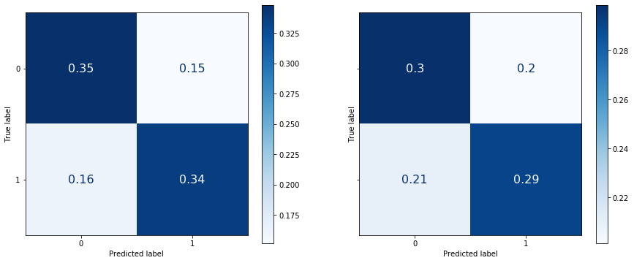
Present the results
TF-IDF & Logistic Regression (2,2)
10000 max features and min df 30
Train score: 0.590
Test score: 0.686
CV score: 0.590

Slide 13
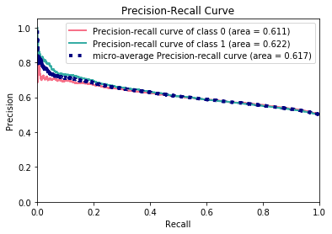
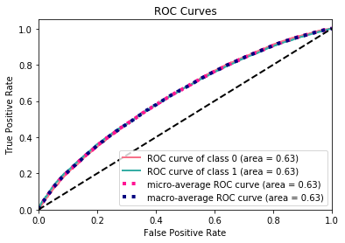
Present the results
TF-IDF & Logistic Regression (2,2)

Slide 14
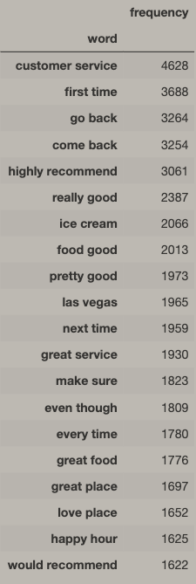
Present the results
TF-IDF & Logistic Regression (2,2)

Slide 15
Build a model
Using TF-IDF ideal parameters but on ngrams (1,1), I gridsearched hyperparameters for 4 classifiers:
Logistic Regression - binary classification.
Naive Bayes (Bernoulli) - binary classifier
Linear SVC
RBF SVC
Notes:
Logistic Regression
Success Metric: Model coefficcients

Slide 16
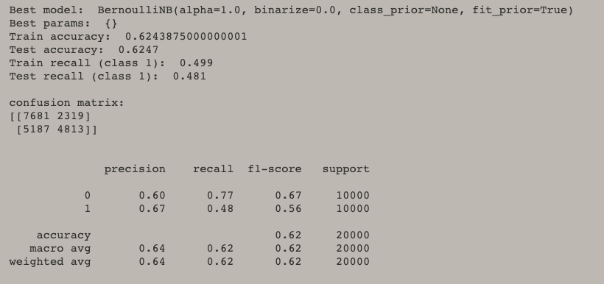
Present results - best TF-IDF (1, 1) params
Notes:
Binary Naive Bayes

Slide 17
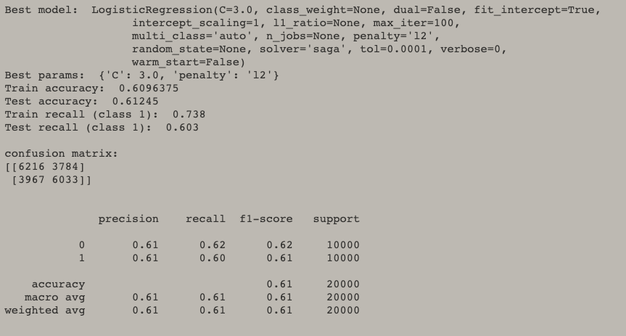
Present results - best TF-IDF (1, 1) params

Slide 18
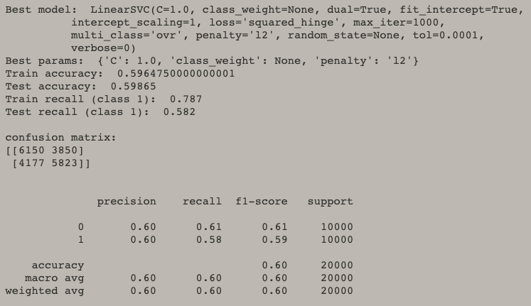
Present results - best TF-IDF (1, 1) params

Slide 19
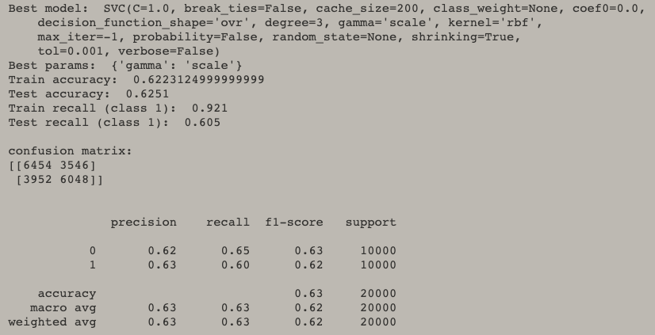
Present results - best TF-IDF (1, 1) params

Slide 20
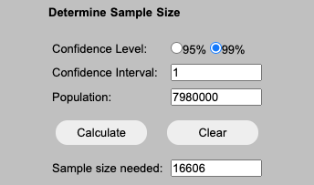
Risk and Limitations
The 100k sample I chose may not be representative of the 7.9million reviews.
I would need to calculate what the right sample of data to choose using if my confidence interval is 95% of 99% or try and implement Hashing Vectorizer, or use AWS for to model larger data.
All the classification models had a difficult time correctly classifying observations and I was receiving a lot of False Positives.
To train my model I would need to further implement in depth feature engineering, using POS tagging, stemming and lemmatization.
There were always far too many features for the model to correct classify
I would instead focus on a particular business or sector.
Check the length of each review and remove short reviews.
Notes:
Impact, next steps, conclusions
The work continues
POS tagging
- Part of speech tagging - Noun, Pronouns, Adjectives, Verbs, Adverbs, Prepositions, Conjunctions, and Interjections.
- Stemming
- Lemmatization
Pros - Better understanding of what specifically about the service was good therefore makes the review useful.
Cons - might not be so useful in review data, where a lot of the reviews may not be grammatically correct. For example if I ran a count vectorizer to lowercase everything, it may not be the correct thing to do with Nouns.
Stemming - reduces word to (psuedo)-stems
Lemmatization - much more harsh than stemming, reduces word-form to linguistically valid-lemmas.

Slide 21
Thank you Christoph, Dan!
Well done team and all the best in your Data Science careers!

Slide 22
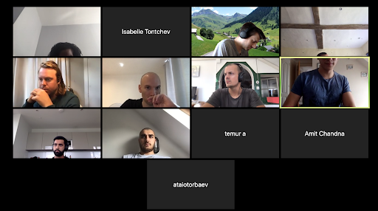
Questions, comments, concerns?

Slide 23
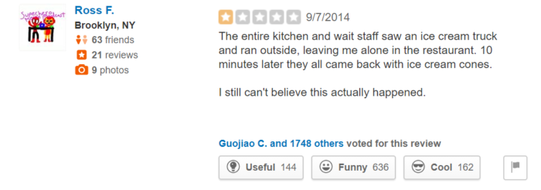
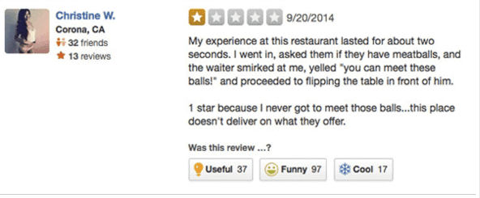
Sarcasm detector

